Slide 1
In-Air WiFi Insights
August 9, 2022

Slide 2
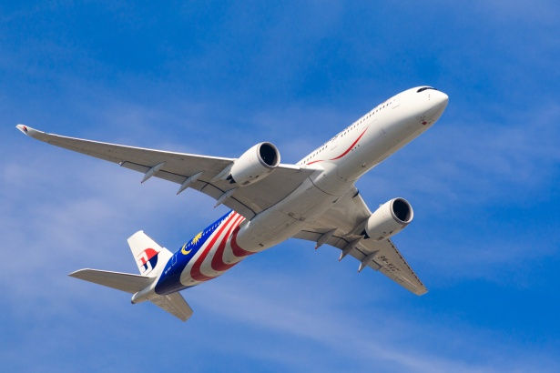

Overview
The satisfaction of in-flight wifi connectivity contributes to our travel experience as we rely on it for work, entertainment, and social media.
As a traveler, a smooth connectivity can to turn travel time into productivity/entertainment time.
For airliners, stellar wifi can be a means to attract/retain customers.

Slide 3
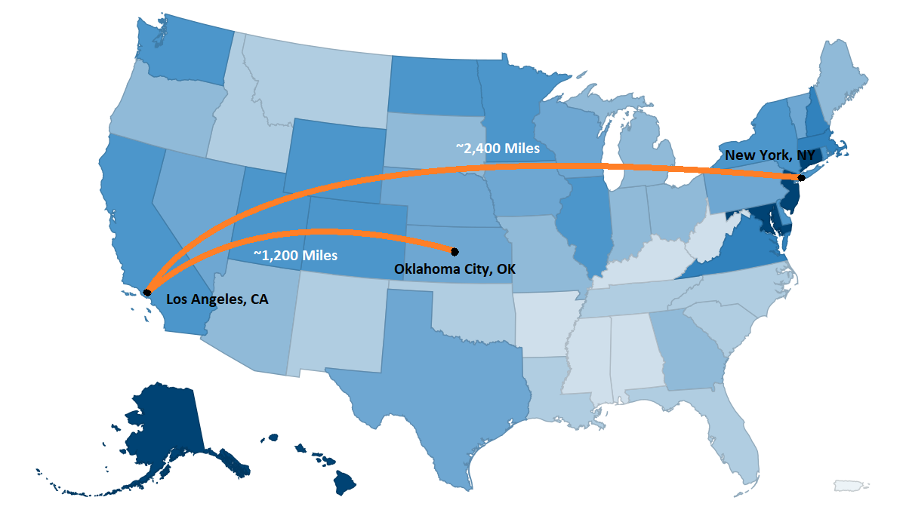
Research Question
Does travel distance affect customer satisfaction for inflight wifi?
Are there any significant differences in inflight wifi satisfaction between short (<1200 miles), medium (1200-2400 miles), and long (2400+ miles) distance travelers?

Slide 4

The Data
We looked at approximately 26,000 data points from Airline survey data.
Flights were dated from September 2021 - July 2022.
Survey answers ranging from 0 (not satisfied) to 5 (very satisfied).
Here’s what we did…

Slide 5
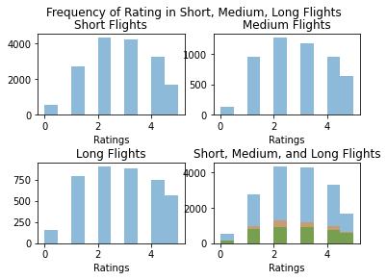
The Analysis I
We broke up the data into 3 parts: short (<1200 miles), medium (1200-2400 miles), and long (2400+ miles) distance travelers.
looked at how many ratings are there in each category of 0-5.

Slide 6
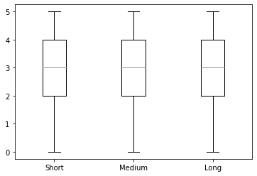
The Analysis II
Used ANOVA to quantitatively determine if there’s any differences. The result was, there’s no significant statistical difference in the groups.
We use the boxplot to visually compare the data and confirm and the result.

Slide 7
Conclusion and Recommendation
With results of ANOVA and the Tukey's, we conclude that there are no significant difference between groups in question. That is, travel distance does not affect passengers' satisfaction ratings towards wifi.
Recommendations…
We recommend looking into other factors that might drive wifi ratings in order to improve wifi satisfaction measures.

